Slide 1
Coursera Data Science Capstone Project Report
Aditya Mahajan

Slide 2
Contents
Introduction/business problem
Data
Methodology
Results
Discussion
Conclusion

Slide 3
Introduction/Business Problem
Client needs help to start new business
Target segment – Luxury fashion
Target Country – US
Budget – No Upper Bound
Task:
Find the right metropolitan area with:
Strong potential buyers
Right market size
Find the trending businesses in the similar sector
Find the popular locations where these businesses are accumulate

Slide 4
Data
Data of incomes of top 1% people across metropolitan areas in the US
Ratio of top 1% income to bottom 99% income for all U.S. metropolitan areas, 2013 (Source: Internal Revenue Service SOI Tax Stats (various years), and Piketty and Saez (2012). Core Based Statistical Areas defined by the U.S. Census Bureau, Population Division; Office of Management and Budget, February 2013 delineations)
Data of population across metropolitan areas in the US
https://www.currentresults.com/Weather-Extremes/US/largest-cities-list.php
Foursquare dataset of:
Popular businesses in luxury/fashion segment in a given area
Popular hubs/ hotspots for such businesses in the chosen area
https://foursquare.com/developers/apps/

Slide 5
Methodology
Extraction
Extract information from the tables and charts available online to dataframes
Refining
Refine data and filter out discrepancies
Checking consistency of naming in datasets of population and incomes
Transform data to meet our needs
Processing
Sorting and filtering the best choices that meet our thresholds:
Areas with population > 3 million
Top 30 spots with high no. of rich
Select the common entries
Graphical analysis of the best choices
Neighborhood Analysis
Choose a popular location as the center coordinate
Search neighborhood for resembling business domains
Identify the popular localities where these businesses are based

Slide 6
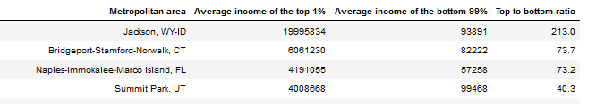
Results
After extraction and refining the data we get the following dataframe
Similarly we get a refined dataset for the population dataset as well

Slide 7
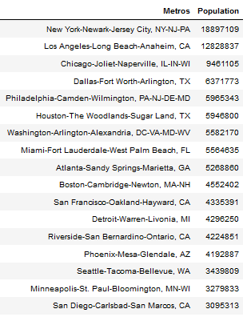
Results
Next we apply different filters and operations to extract useful information
The areas with population > 3 million are as follows:

Slide 8
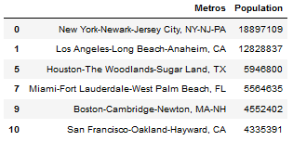
Results
A list of cities that meet both criteria are as follows:

Slide 9
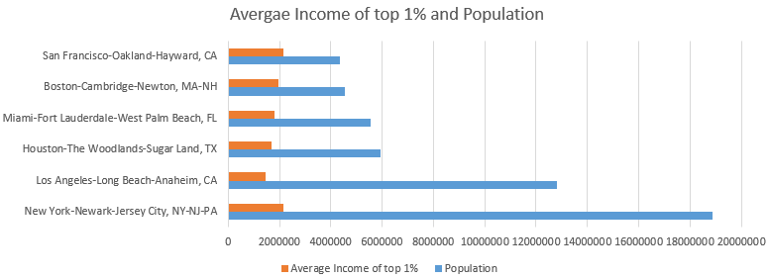
Results
Now we need a graphical analysis to tell us which are the top choices that are best of both worlds
Clearly, New York and LA perform way better than the rest, however, New York turns out to be the best choices

Slide 10
Results
A quick survey reveals that the Upper East Area in New York is the most popular spots for luxury brands.
We find its coordinates and make a query in Foursquare about the fashion brands in the areas (radius 1km and limit 400)
Once we extract these, we refine the data to a more interpretable form that can be easily compared.
We further identify the categories of each store & address locations where these are located.

Slide 11
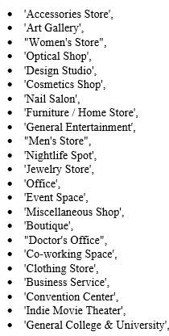
Results
Following this we get suggestions about the type of businesses that exist in the given region and also lie under the fashion category

Slide 12
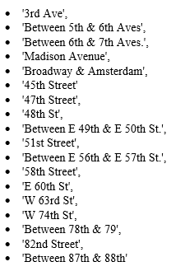
Results
We also get a good idea about the streets which are popular choices among these businesses and that attract the target customers

Slide 13
Discussion
Hence, our client now has a pretty refined set of choices which came out as a result of our thorough data analysis.
The client can now decide what businesses have scope of opening up in this region and where is are the best places.
This study was aimed at providing a way to identify the hubs or hotspots for a particular industry or market.
In our case it was the luxury fashion segment.
This project highlights the vitality of using these tools for data analysis.
We derive meaningful insights from a crude dataset and help people to make smarter choices with strong evidences.

Slide 14
Conclusion
Our work provides our client access to set of choices that:
meet his/her requirements
hint him/her to choose the sort of businesses with respect to the place
As per our analysis the client should start the business in the New York –New Jersey metropolitan area – Upper East Area
The set of locations & businesses prevailing in the area were found.
In fact, some of results are very similar to the top net searches like suggestions of places like 5th Avenue, Broadway etc.
However, while some business suggestions like jewelry stores, cosmetics etc. were obvious, others were really interesting and might not be very obvious when searching the net like Universities about Fashion, Indie Movie Theatres etc.
These could help our client make the choices in a more informed manner and start a new business with much more ease.

